Slide 1

Slide 1
FOOD EXPRESS APPLICATION
By Team-2

Slide 2
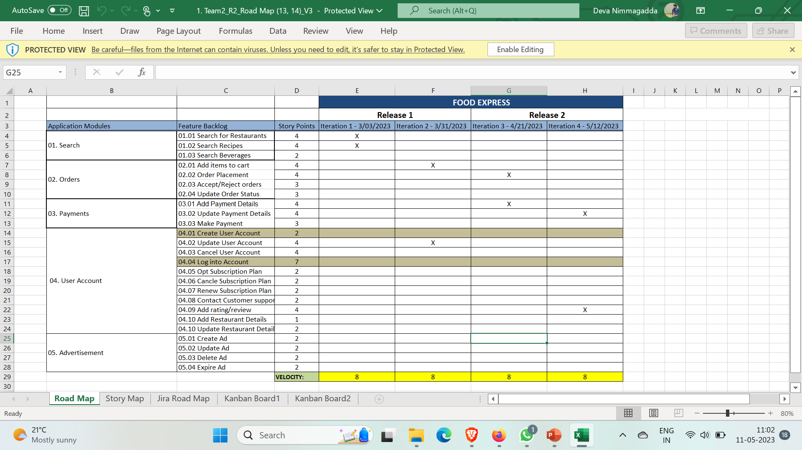
Roadmap

Slide 3
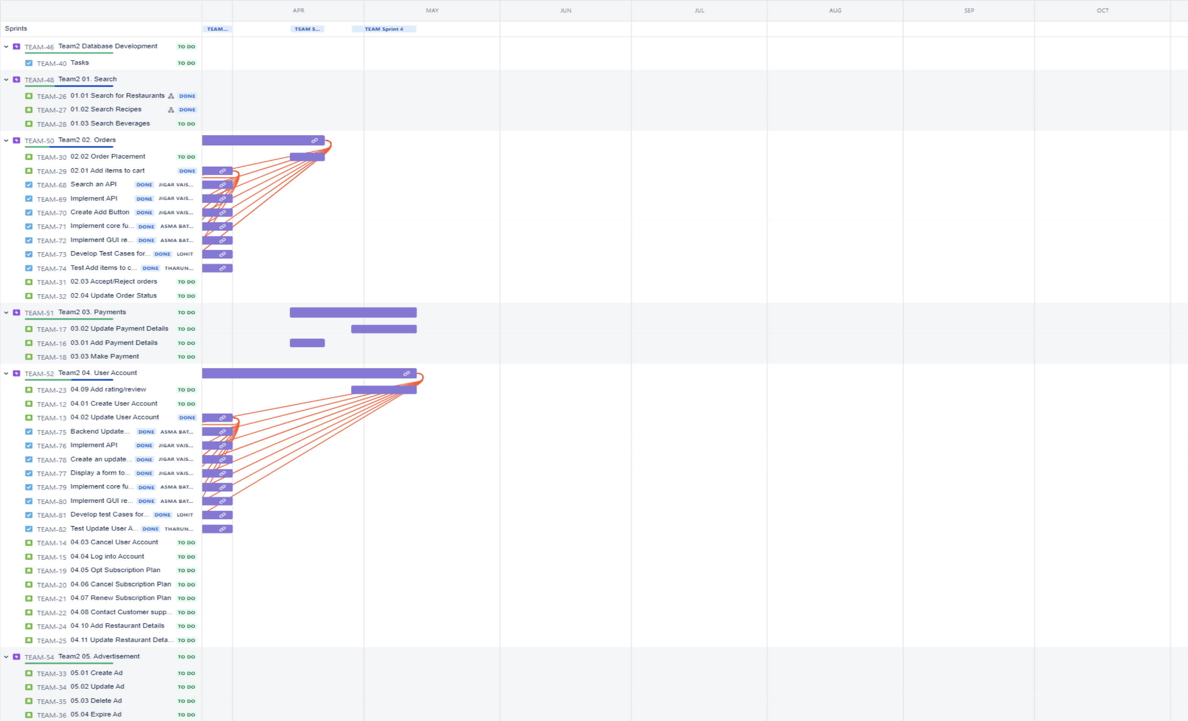
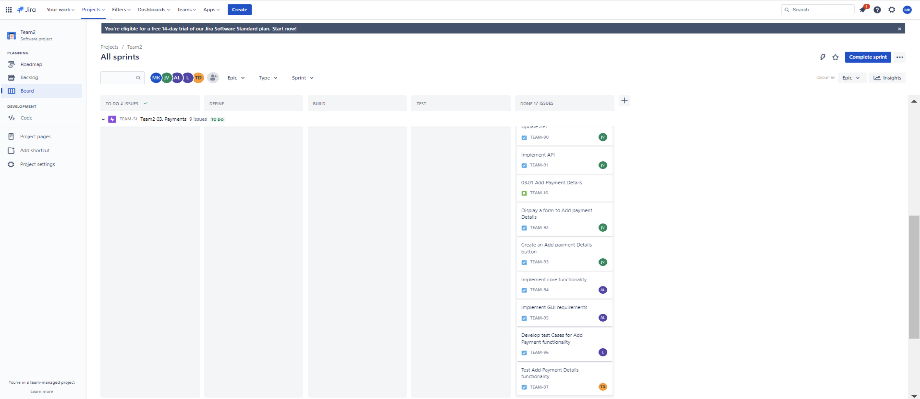

Slide 4
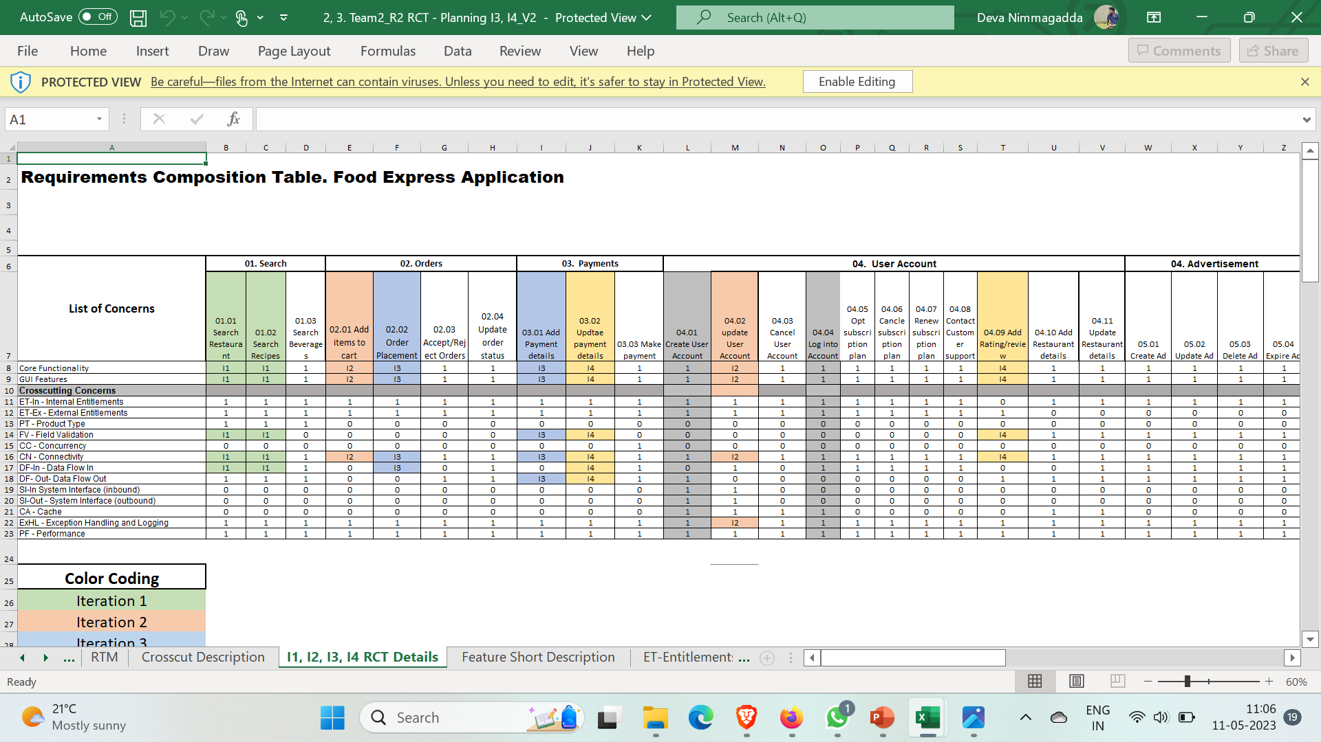
RCT

Slide 5
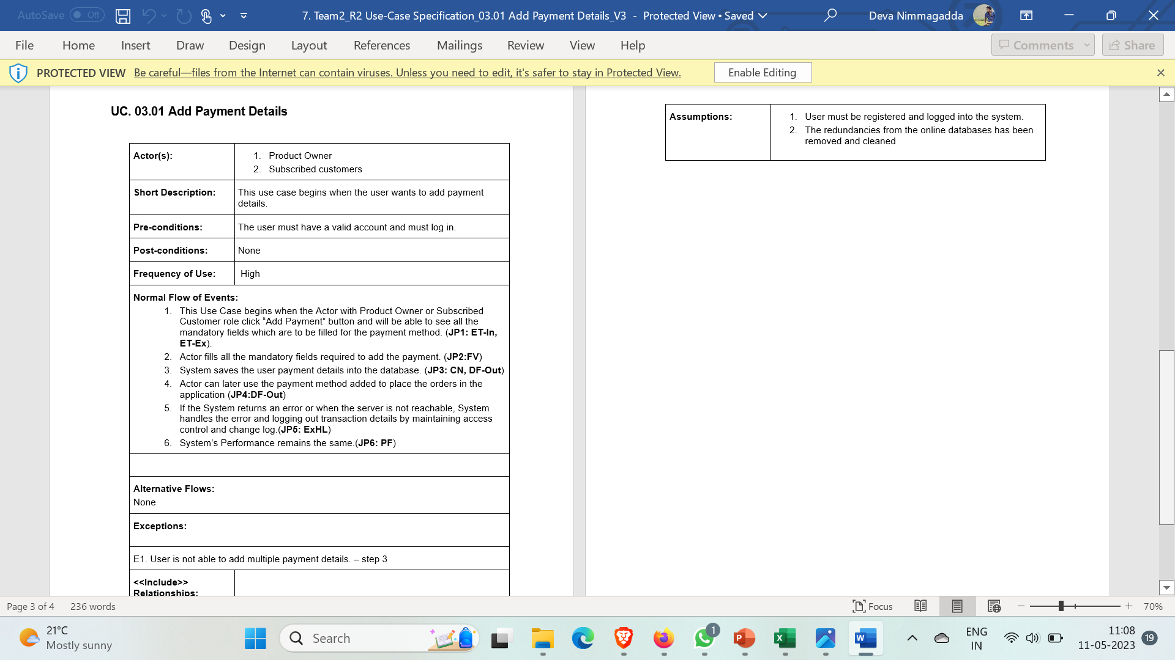
USE CASE SPECIFICATIONS

Slide 6
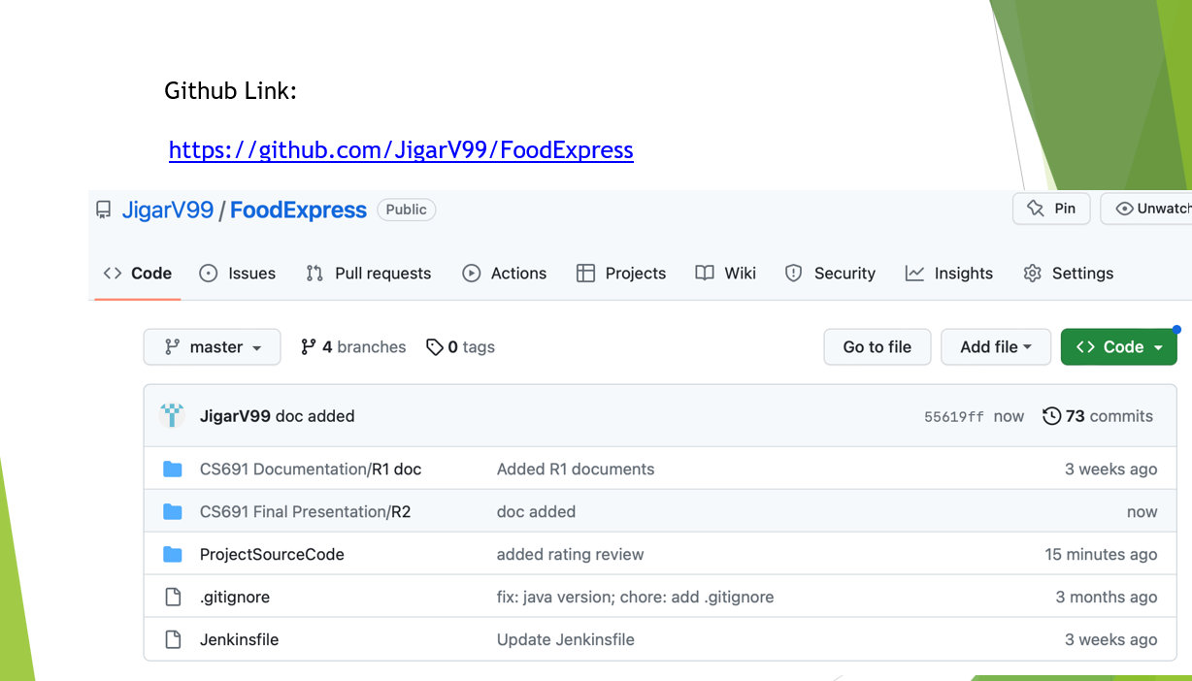

Slide 7
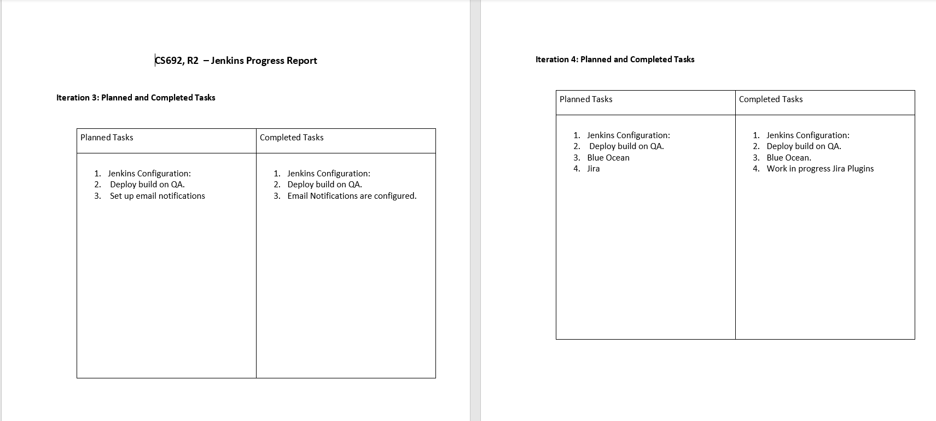
JENKINS PROGRESS REPORT

Slide 8
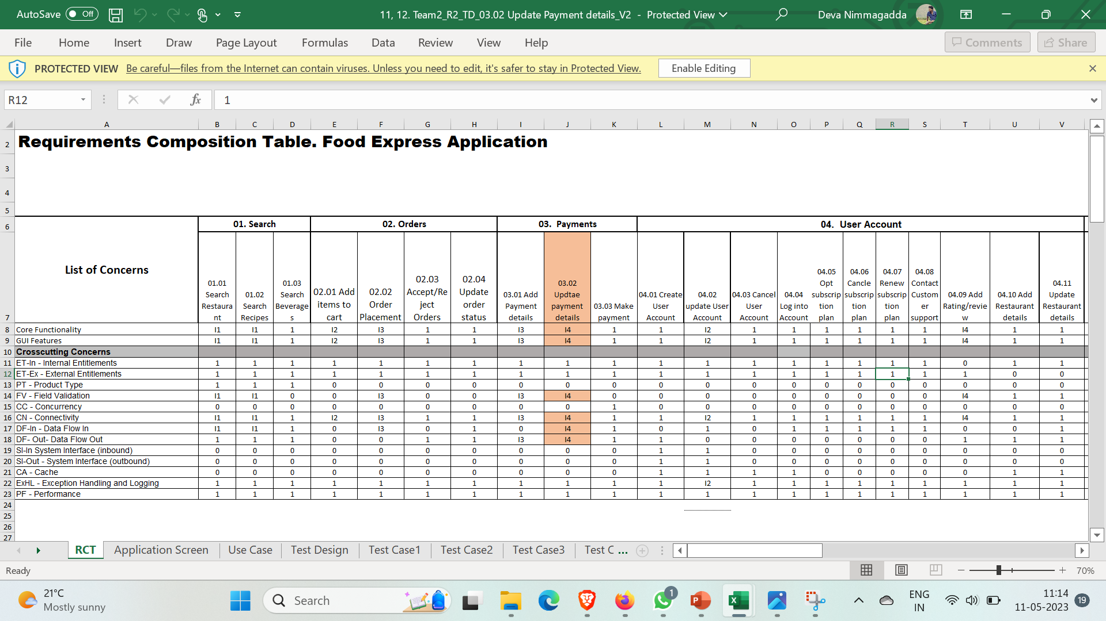
Test cases

